Slide 1
2978 persons were attacked with acid from 2357 incident during the period from 1999 - 2009,.

Slide 2
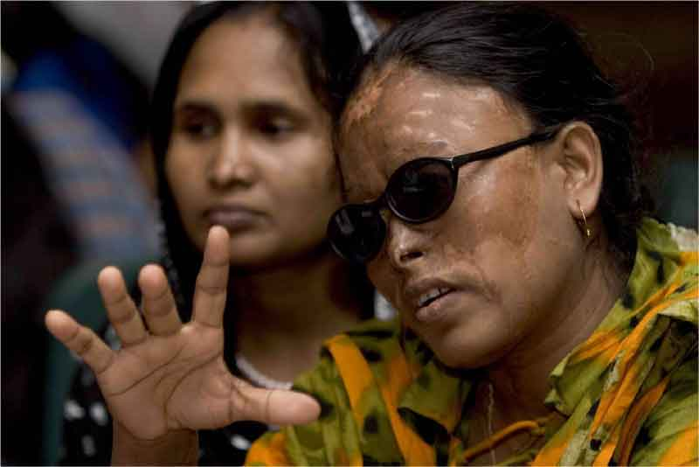

Slide 3
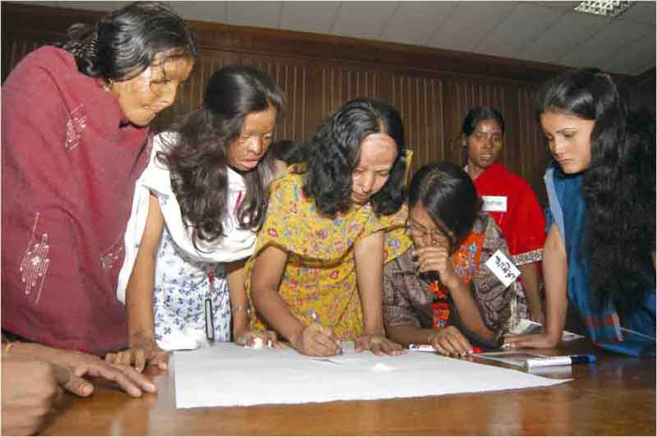

Slide 4
